Slide 1


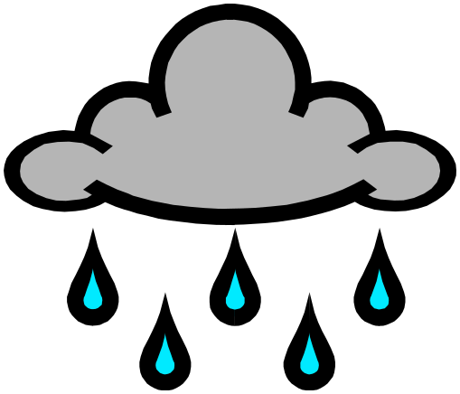

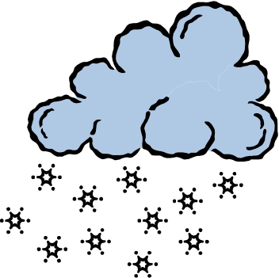
Types of Precipitation
Sleet
Rain
Hail
Snow

Slide 2
Precipitation Starts With Different
Air Masses Being Pushed Around by Global Winds
High pressured air mass
Warm, Dry air mass
Wet, humid air mass
Cold air mass
Low pressured air mass
Obviously, these moving air masses will eventually bump into one another.

Slide 3
When 2 or more different air masses meet, the place where they bump is called…
Front
Warm air mass
Cold air mass
A storm, usually with precipitation, occurs at this front.

Slide 4
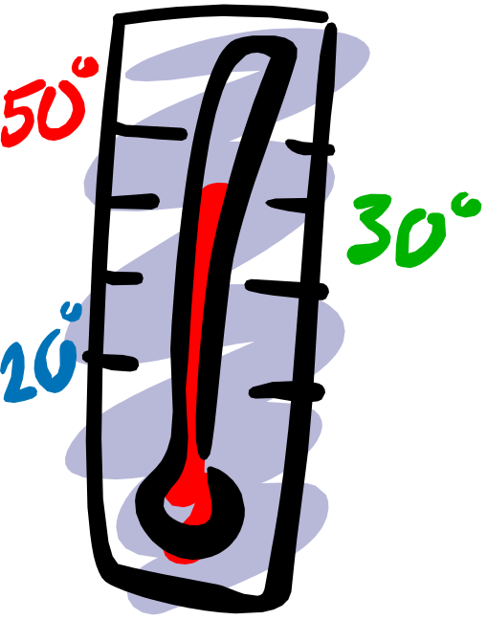
The type of precipitation that falls from the clouds to the surface of the Earth depends on ONE main thing…
TEMPERATURE
The temperature of the clouds vs. the temperature of the surface air.

Slide 5
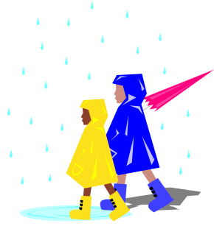
RAIN
Rain occurs when precipitation falls from the clouds as liquid water.
During a rain storm, the temperature is warm in the clouds and…
WARM Clouds
warm at ground level so...
Warm surface
precipitation is in melted, liquid form.

Slide 6

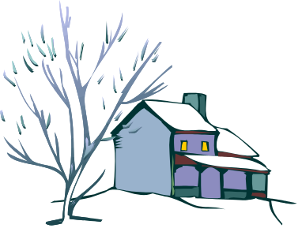
Snow
Snow occurs when precipitation falls from the clouds as cold, flaky solids.
During a snow storm, the temperature in the clouds is very cold which freezes the rain into ice crystals and…
Freezing cold clouds
It is also Cold at ground level so…
Freezing COLD surface
precipitation is frozen solid in the clouds and stays frozen by the cold surface.

Slide 7

Sleet
Sleet occurs when precipitation falls from the clouds to the ground as half water/half ice.
During a sleet storm, the temperature of the clouds is warm, so the precipitation begins to fall as…
Warm Clouds
liquid rain.
But, the air around the surface is very cold, so it begins to freeze the liquid into a slushy solid.
Freezing Cold surface
This slushy solid, which is half frozen, falls to the ground as sleet.

Slide 8

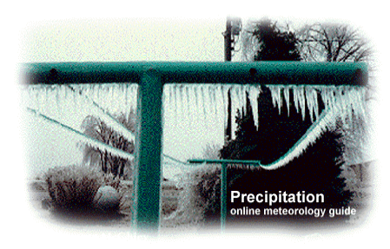
Sleet storms are sometimes called ice storms.
Because the surface temperature is very cold during a sleet storm and everything usually gets covered in ice.

Slide 9


HAIL
Hail is precipitation that falls from the clouds to the surface as balls of ice.
Freezing Cold Clouds
and grows, and grows and grows, until…
Precipitation in the form of ice begins to fall from the clouds.
But it gets pushed back up by the strong wind back into the clouds where it joins with more ice and grows…
A hail storm begins with warm surface temperatures. Very strong, warm wind currents push upward toward the cold clouds.
The hail stones become so heavy, the wind can’t hold them up in the clouds and they fall to the warm surface.

Slide 10
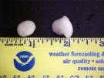
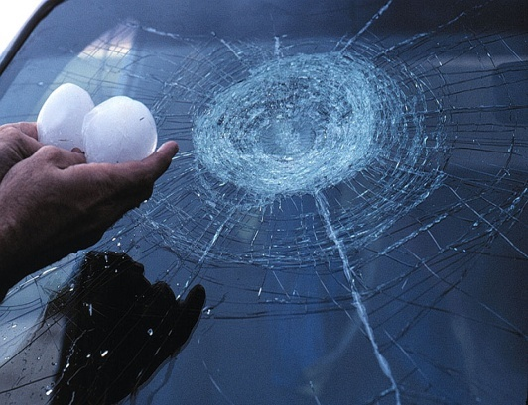
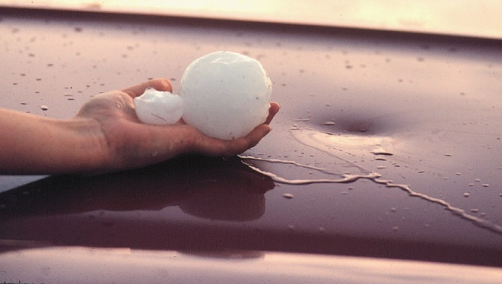
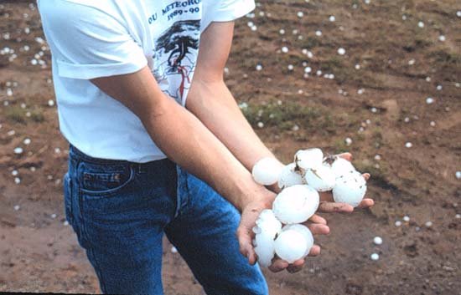
If the upward wind currents are normal, hail stones will usually be as big as marbles.
But if the wind currents are very strong (over 100 miles per hour), the hail stones can stay up in the cold clouds for a long time and grow very large.
These large hailstones cause lots of damage to cars, homes, crops and people.

